Slide 1

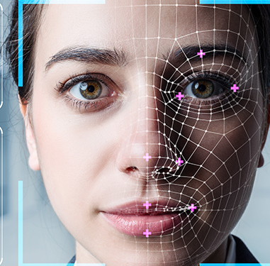
Face Recognition using a dynamic time warping algorithm
Group: Project task 1- group 4 Group Members:
- Singari Sahith Kumar (1446809)
- Bandaru Vinay Kumar (1447125)

Slide 2
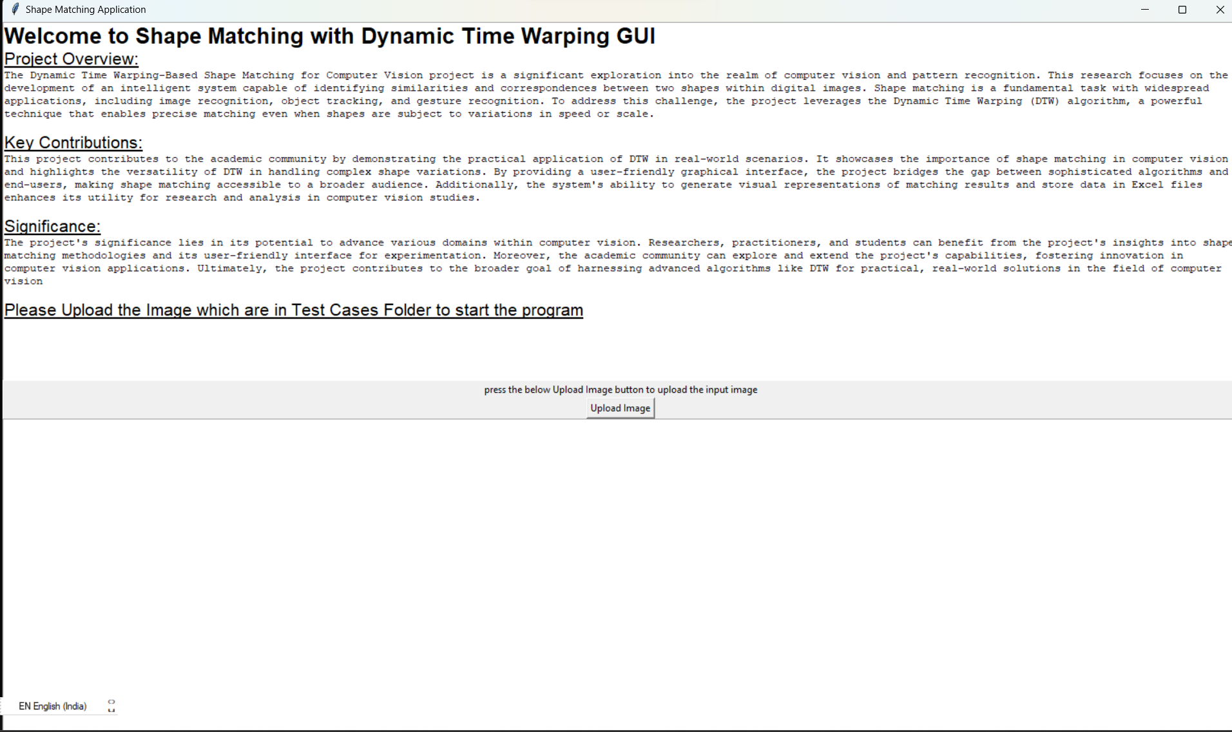
GUI Interface
The graphical user interface (GUI) opens immediately upon executing the "dynamic_time_warping.py" project

Slide 3
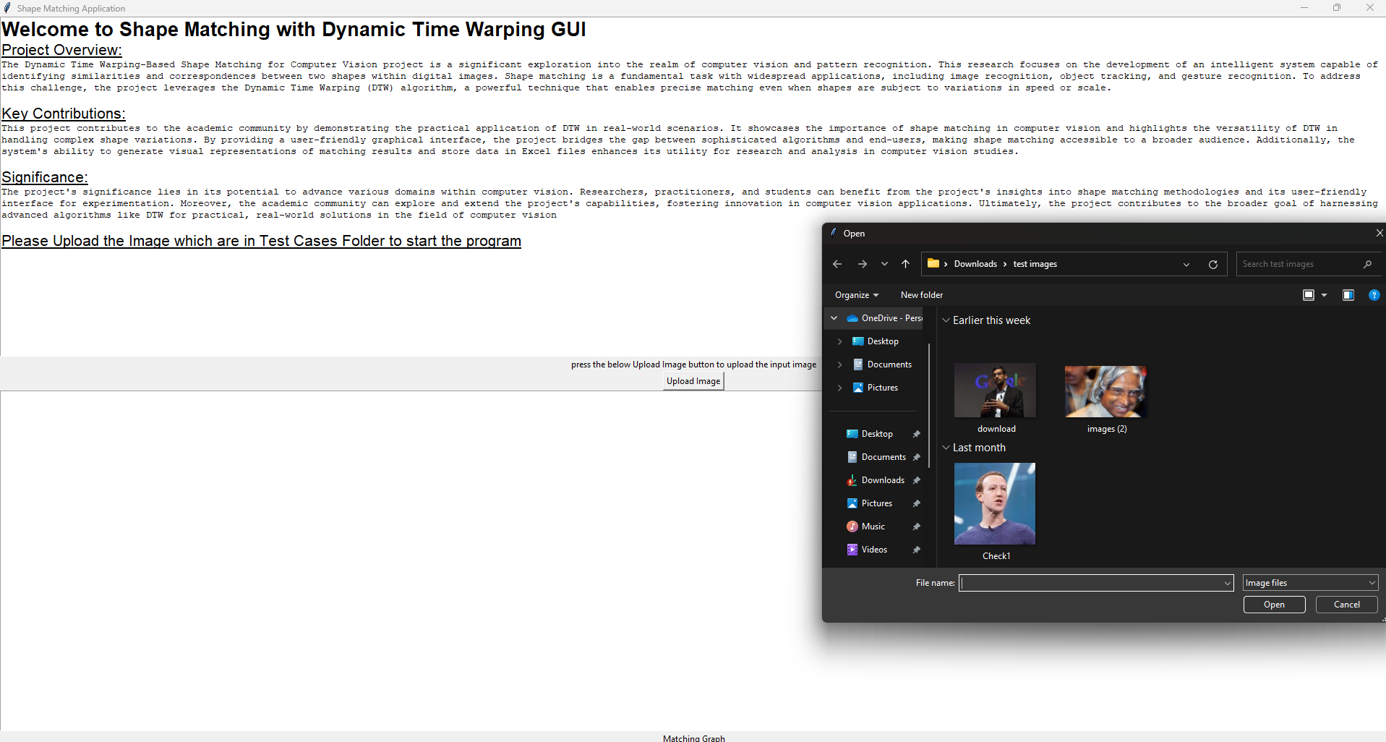
Clicking the "Upload Image" button will open a window that allows you to select the desired image for input. Images can be found in “Test_Cases” folder

Slide 4
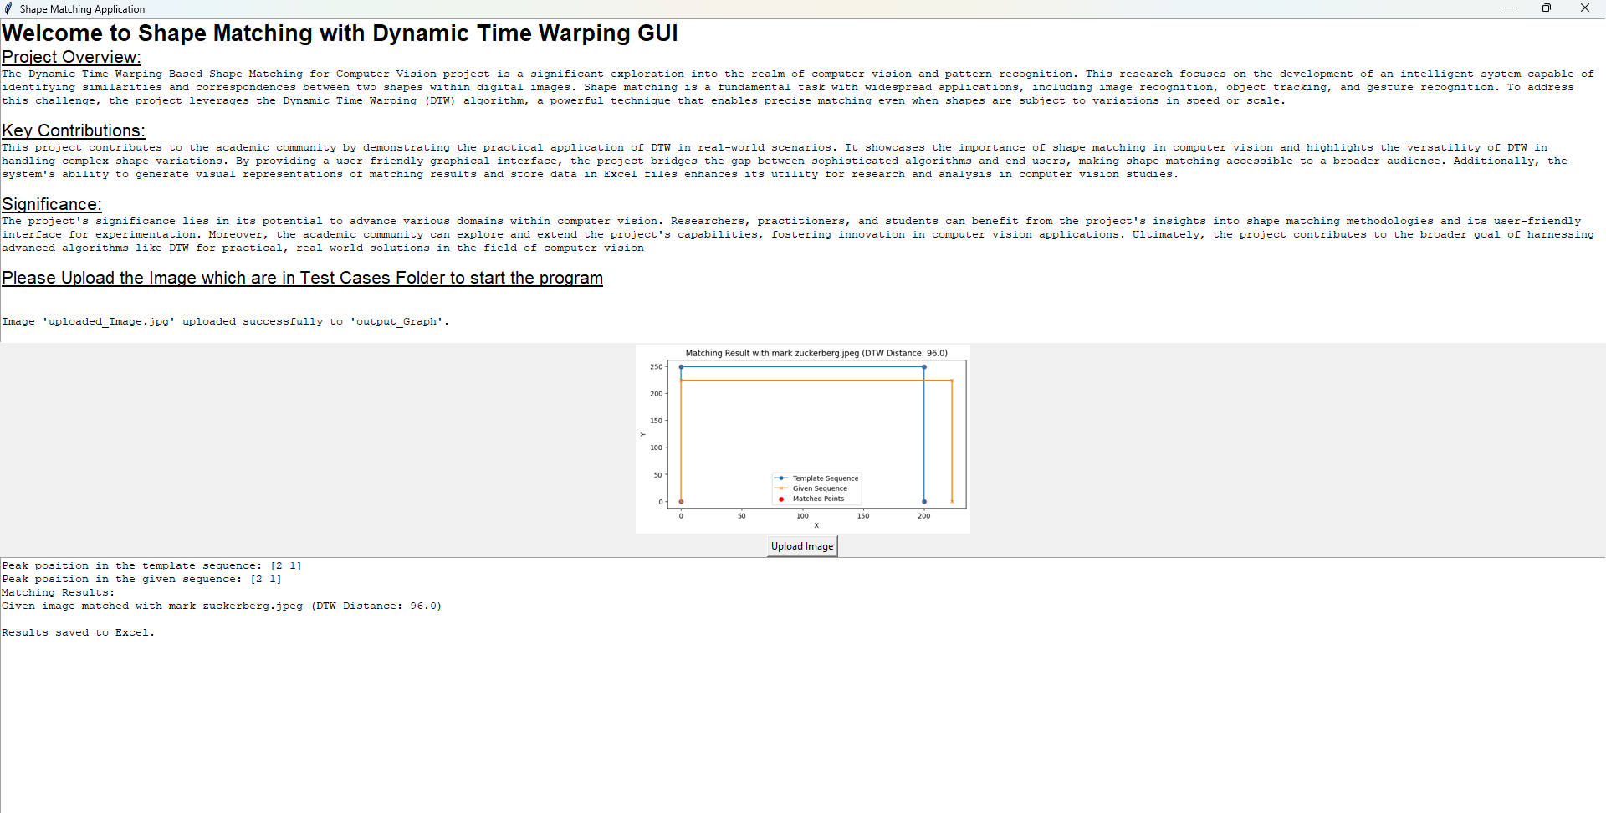
Once the image is uploaded, the following output will be generated, featuring a graphical representation of the matching points, the Template Sequence, the Given Sequence, as well as textual information on "peak positions" and the DTW distance

Slide 5

Code Explanation
GITHUB Link

Slide 6
import cv2
import os
import pandas as pd
from fastdtw import fastdtw
import numpy as np
import matplotlib.pyplot as plt
import tkinter as tk
from tkinter import filedialog
from tkinter import messagebox
from tkinter import PhotoImage
from tkinter import filedialog
from PIL import Image, ImageTk
import shutil
import cv2: This imports the OpenCV library, which is commonly used for image processing and computer vision tasks.
import os: This library provides functions for interacting with the operating system, allowing you to manage files and directories.
import pandas as pd: The pandas library is used for data manipulation and analysis. In this project, it's utilized to work with data frames.
from fastdtw import fastdtw: This imports the fastdtw function from the fastdtw library. fastdtw is an efficient implementation of the Dynamic Time Warping (DTW) algorithm.
import numpy as np: NumPy is a fundamental library for numerical computations in Python. It's used for working with arrays and matrices.
import matplotlib.pyplot as plt: Matplotlib is a popular library for creating visualizations and plots. In this project, it's used to generate graphs and visualizations.
import tkinter as tk: The tkinter library provides tools for creating graphical user interfaces (GUIs).
from tkinter import filedialog: This imports the filedialog module from tkinter, which is used to open file dialogs for file selection.
from tkinter import messagebox: The messagebox module from tkinter allows you to display pop-up message boxes in the GUI.
from tkinter import PhotoImage: PhotoImage is used to load and display images within the GUI.
from tkinter import filedialog: This is another import statement for the filedialog module, which is used for opening file dialogs.
Block 1: Imports
GITHUB Link

Slide 7
app = tk.Tk(): This line creates the main application window and assigns it to the variable app.
app.title("Shape Matching Application"): It sets the title of the application window to "Shape Matching Application".
screen_width = app.winfo_screenwidth(): This line retrieves the width of the screen where the application is running.
screen_height = app.winfo_screenheight(): It gets the height of the screen.
app.geometry(f"{screen_width}x{screen_height}"): The geometry method sets the size of the application window to match the screen width and height. This ensures that the window fits the entire screen.
# Create the main application window
app = tk.Tk()
app.title("Shape Matching Application")
screen_width = app.winfo_screenwidth()
screen_height = app.winfo_screenheight()
app.geometry(f"{screen_width}x{screen_height}")
Block 2: Main Application Window
GITHUB Link

Slide 8
Create a label (image_label) with instructions for the user. This label provides guidance on how to upload an image.
Set the text to "press the below Upload Image button to upload the input image."
image_label = tk.Label(app, text="press the below Upload Image button to upload the input image")
image_label.pack()
Create an "Upload Image" button (upload_button) for users to upload an image. Add’s the button to the application.
upload_button = tk.Button(app, text="Upload Image")
upload_button.pack()
Block 3: Label for User Instructions and "Upload Image" Button
GITHUB Link

Slide 9
output_folder = 'output_images'
os.makedirs(output_folder, exist_ok=True)
output_graph_folder = 'output_Graph'
os.makedirs(output_graph_folder, exist_ok=True)
Create two folders: "output_images" and "output_Graph" using os.makedirs. These folders will be used to store output images and graphs generated during shape matching.
face_cascade = cv2.CascadeClassifier('haarcascade_frontalface_default.xml')
Load the pre-trained face detection model using OpenCV's Haar Cascade Classifier.
Block 4: Create Folders for Output and Load Pre-Trained Face Detection Model
GITHUB Link

Slide 10
template_sequences = {}
for filename in os.listdir('images'):
if filename.endswith('.jpg') or filename.endswith('.jpeg') or filename.endswith('.png'):
image_path = os.path.join('images', filename)
template_image = cv2.imread(image_path)
template_gray = cv2.cvtColor(template_image, cv2.COLOR_BGR2GRAY)
contour, _ = cv2.findContours(template_gray, cv2.RETR_EXTERNAL, cv2.CHAIN_APPROX_SIMPLE)
template_sequence = np.squeeze(contour)
template_sequences[filename] = template_sequence
Create a dictionary (template_sequences) to store template sequences for shape matching.
Iterate over images in the 'images' folder.
Load, preprocess, and extract contours from template images.
Store template sequences in the dictionary.
Block 5: Load and Preprocess Template Sequences
GITHUB Link

Slide 11
def upload_image():
file_path = filedialog.askopenfilename(filetypes=[("Image files", "*.jpg *.jpeg *.png")])
if file_path:
destination_path = 'output_Graph'
destination_file = 'uploaded_Image.jpg'
shutil.copy(file_path, os.path.join(destination_path, destination_file))
confirmation_text = f"Image '{destination_file}' uploaded successfully to '{destination_path}'."
text_widget.insert(tk.END, "\n\n" + confirmation_text)
text_widget.see(tk.END)
match_shape(os.path.join(destination_path, destination_file))
Define the upload_image function to open a file dialog for image selection.
Copy the selected image to the 'output_Graph' folder.
Display a confirmation message and perform shape matching with the uploaded image.
Block 6: Function to Handle Image Upload
GITHUB Link

Slide 12
# Function to perform DTW shape matching and visualize the result
def shape_matching_with_visualization(template_sequence, target_sequence, threshold):
# Compute the DTW distance and the optimal path
distance, path = fastdtw(template_sequence, target_sequence)
if distance < threshold:
return True, distance, path
else:
return False, distance, path
# Function to save the binary data to an Excel file
def save_data_to_excel(data_frames, output_file):
data = pd.concat(data_frames, ignore_index=True)
data.to_excel(output_file, index=False)
The shape_matching_with_visualization function calculates the DTW distance and the optimal alignment path between a template sequence and a target sequence. If the calculated distance is below a specified threshold, it indicates a successful match and returns True, along with the DTW distance and the optimal path. Otherwise, it returns False with the same information.
The save_data_to_excel function is responsible for saving binary data, typically data frames, to an Excel file. This enables the project to store and organize matching results and other relevant data in a structured format. These functions are essential components of the project, as they facilitate the DTW-based shape matching and result visualization while also enabling data storage for further analysis and reference
Block 7: Function to perform DTW shape matching and visualize the result
GITHUB Link

Slide 13
# Function to perform DTW shape matching
def shape_matching(template_sequence, target_sequence, threshold):
# Compute the DTW distance between the sequences
distance, _ = fastdtw(template_sequence, target_sequence)
if distance < threshold:
return True, distance
else:
return False, distance
The shape_matching function in your code implements Dynamic Time Warping (DTW) shape matching. It calculates the DTW distance between a template sequence and a target sequence, measuring their similarity. If the computed distance is less than a specified threshold, the function returns a Boolean value of True, indicating a successful match, along with the distance value. Otherwise, it returns False to signify that the sequences do not match within the given threshold. This function is essential for determining whether two shapes are similar enough for further analysis or recognition
Block 8: DTW shape matching
GITHUB Link

Slide 14
matching_results_text = tk.Text(app, wrap=tk.WORD)
matching_results_text.pack(fill=tk.BOTH, expand=True)
Create a Text widget (matching_results_text) for displaying matching results.
Set text wrapping and add it to the application.
graph_label = tk.Label(app, text="Matching Graph")
graph_label.pack()
Create a label (graph_label) for displaying matching graphs.
Set its text to "Matching Graph."
Block 9: Create Text Widget for Matching Results and Create Label for Displaying Graphs
GITHUB Link

Slide 15
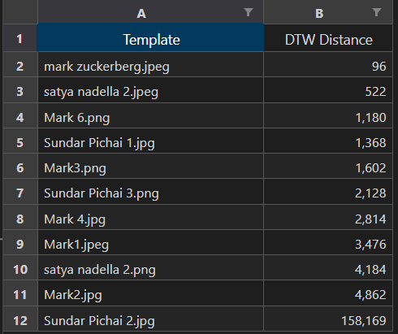
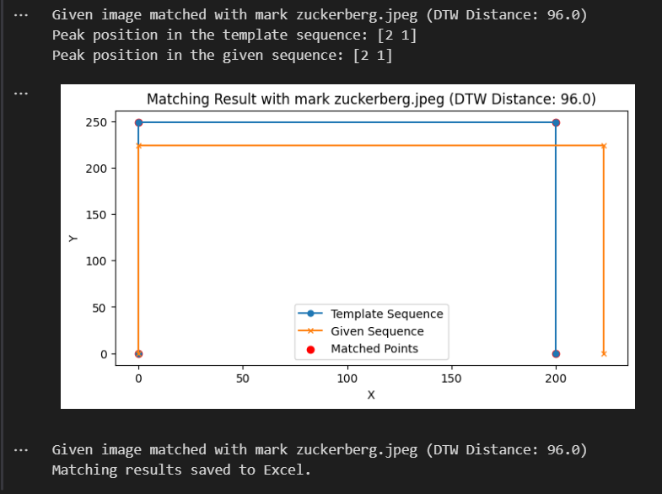
OUTPUT IMAGES FOR ALGORITHM:Case1

Slide 16
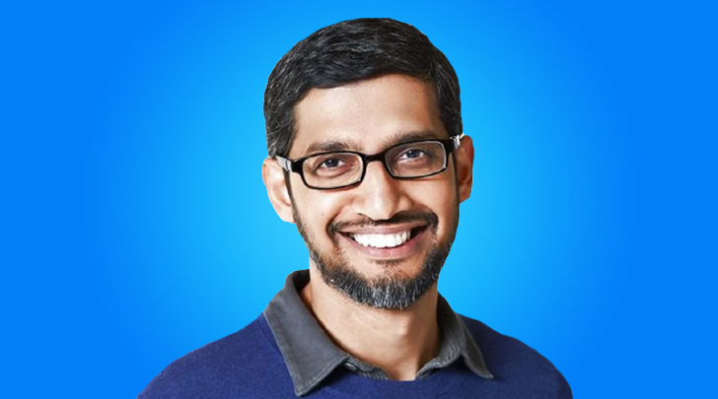
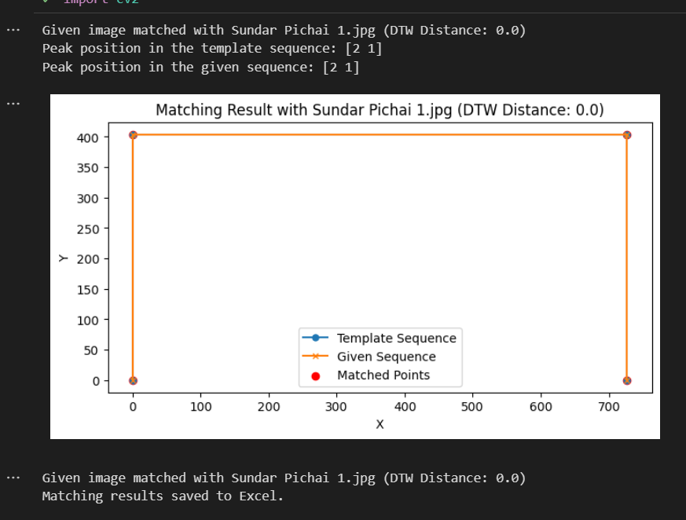
OUTPUT IMAGES FOR ALGORITHM:Case2

Slide 17


